Slide 1
E-SPLOST VI Facts and Information
December 2023

Slide 2
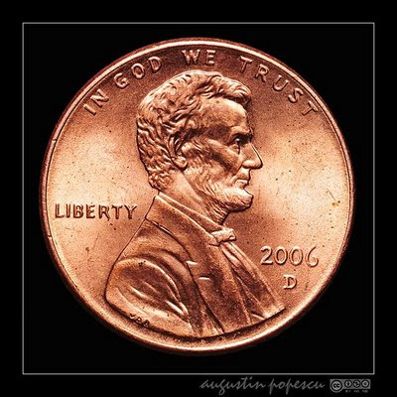
Education Special Purpose Local Option Sales Tax
What is E-SPLOST?
It is a one penny sales tax that allows for shared contribution to education, including visitors to the county who spend money on gas, food, hotels, and retail items.

Slide 3
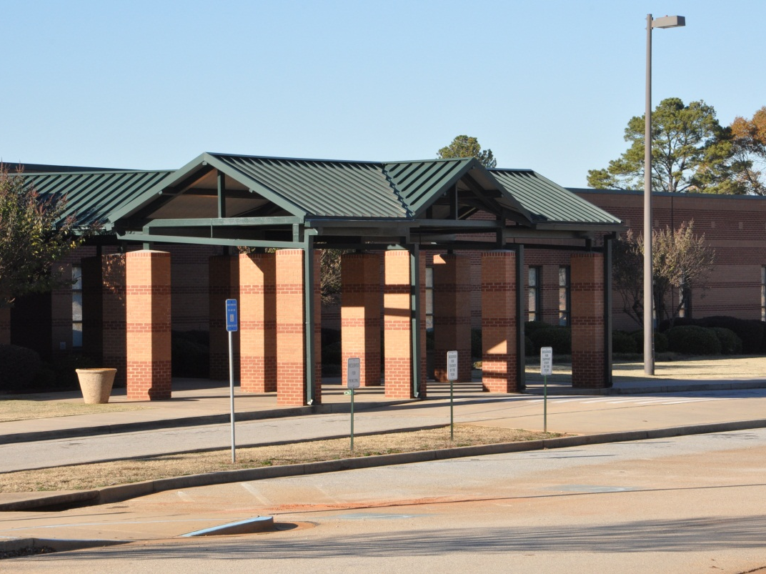
What Can E-SPLOST be used for?
Capital expenditures
Debt retirement
RCPS is a debt –free school system.

Slide 4
E-SPLOST VI will continue a twenty-five-year collection of pennies for public education in Rockdale County Information & Process
E-SPLOST V = $85 million
Collection period beginning April 2019
Collection period ended September 2023
E-SPLOST VI = $135 million
Collection period beginning July 2024
Collection period ending July 2029

Slide 5
E-SPLOST History in Rockdale County
E-SPLOST I Goal $58,952,117 Collected $58,602,335 99%
E-SPLOST II Goal $79,555,700 Collected $65,596,999 83%
E-SPLOST III Goal $94,804,445 Collected $69,843,000 74%
E-SPLOST IV Goal $83,600,000 Collected $75,281,116 89%
E-SPLOST V Goal $85,000,000 Collected $85,000.00+ 100%
E-SPLOST VI Proposed $135,000,000

Slide 6
E-SPLOST VI Proposed Capital Projects
Safety and Security
RCPS Strategic Plan: Goal Area IV
Teaching and Learning
RCPS Strategic Plan: Goal Area II
Technology
RCPS Strategic Plan: Goal Areas II and V
Facilities
RCPS Strategic Plan: Goal Area V

Slide 7
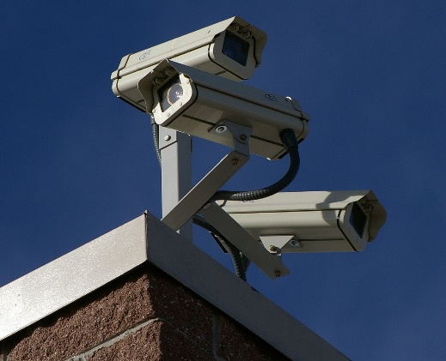
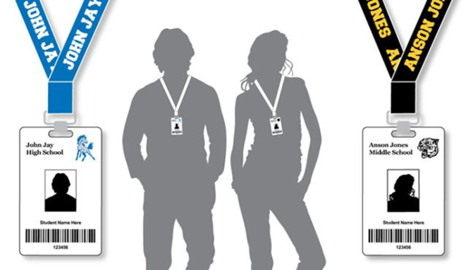
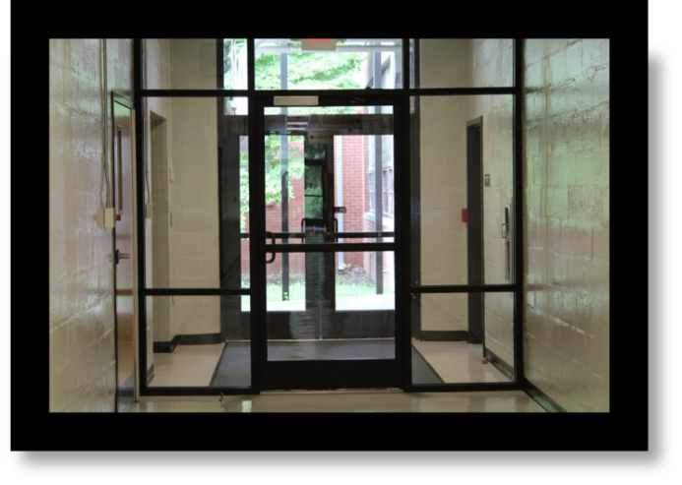
Safety and Security
Communications / Surveillance Equipment
Security camera upgrades/expansions
Expand key card access (interior, general use areas)
Add buzz-in door options at front desks

Slide 8
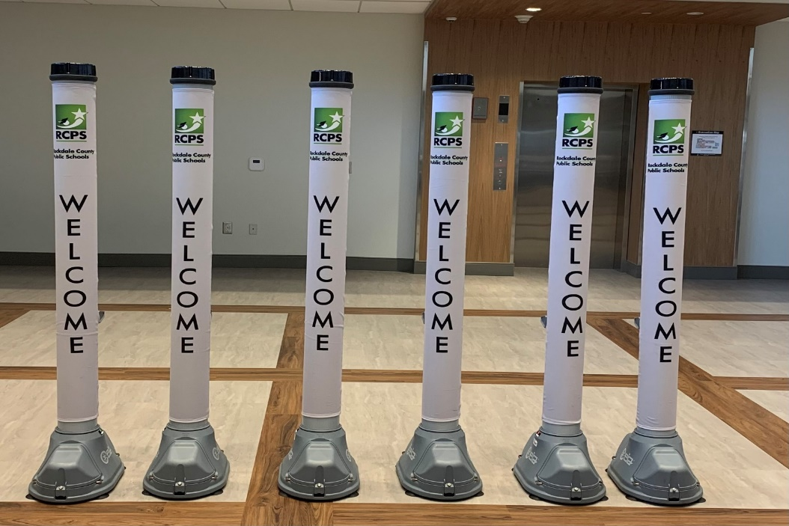
Safety and Security
Safety and Security Equipment
Replace select AEDs districtwide
Security vehicles replaced through the district fleet rolldown process
Open Gate purchases for all site locations

Slide 9
Teaching and Learning
Instructional Supplies
Textbooks
This Photo by Unknown Author is licensed under CC BY

Slide 10
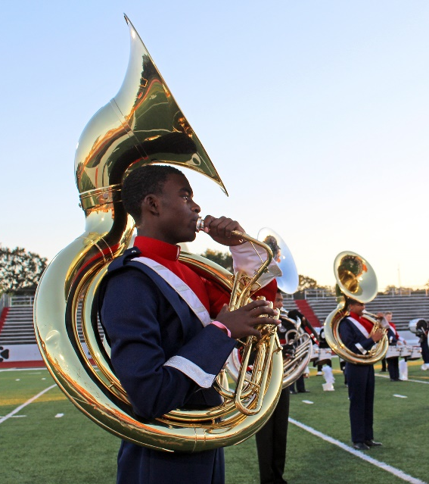
Teaching and Learning
Specialty and School Programs
Band uniform replenish
Athletic safety equipment and uniforms
Musical instruments
Miscellaneous art program equipment
Film career pathway space for training and equipment
This Photo by Unknown Author is licensed under CC BY

Slide 11
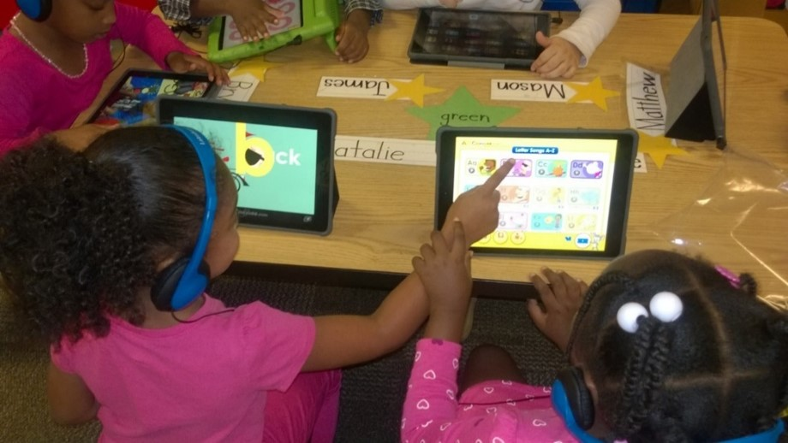
Learning Reimagined 1:1 program
Technology
Replacement cycle for student laptops, grades 2-12
Replacement cycle for student iPads, grades Pre-K – 1
Replacement cycle for teacher laptops
Replacement cycle for staff laptops

Slide 12
Technology
Infrastructure upgrades
Classroom modernization
Wireless network
Administration computers

Slide 13
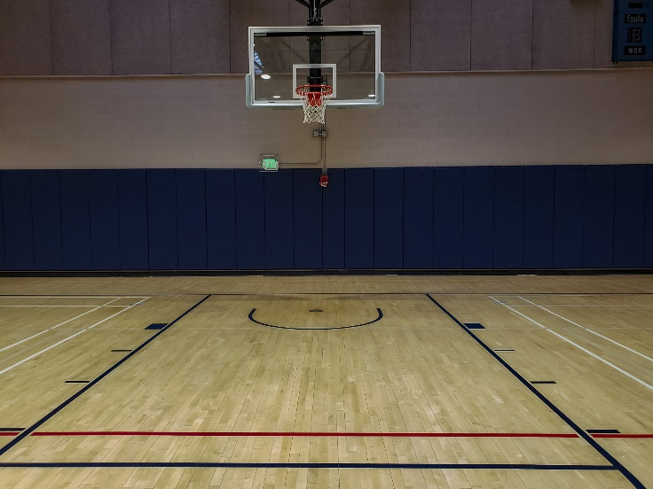
Facilities
Athletic Upgrades/Refurbishing
Protective athletic equipment
Digital scoreboards
Gym floors
Baseball / softball fields
Track refresh
HHS gym

Slide 14
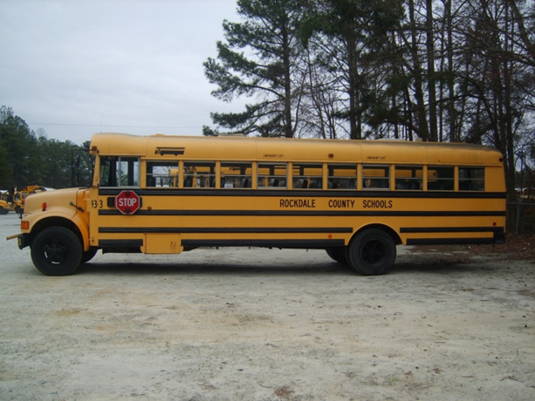
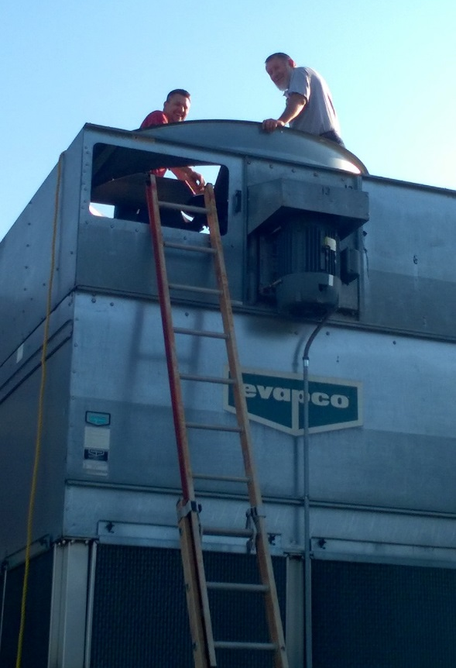
Facilities
Upgrading the Fleet
Buses
Fleet Vehicles
Local Facilities Plan - Site Improvements:
HVAC Upgrades
LED Lighting
Back-up Power Gen
Painting
Pavement/parking lot striping
Signage
Flooring
Power upgrades
Potential Land Purchase for Future Schools

Slide 15
Completed Projects from E-SPLOST I and II
E-SPLOST I
Barksdale Elementary additional land and stage
Roofing at BES, FSE, and HHS
RCHS Auditorium, Additions, and Renovations
HHS and SHS Auditorium Additions
Peek’s Chapel Elementary
Evans Stadium at HHS
Debt retirement
Bus facility maintenance and underground fuel storage
E-SPLOST II
The Rockdale Career Academy and additions
General Ray Davis Middle School
C. J. Hicks Elementary School
Athletic facility improvements at RCHS, HHS, and SHS
Fine Arts Addition at HHS
Alpha Academy and County Office Renovations
Technology Infrastructure
Debt Retirement
Buses
Painting, paving, and energy efficient retrofits throughout the district

Slide 16
Completed Projects from E-SPLOST III and IV
E-SPLOST III
SHS Addition
RCHS Annex Renovation for Magnet Program
PSE Renovations
CMS Expansion and Renovations
EMS Expansion and Renovations
MMS Renovations
RCHS Gym Addition and Renovations
Land Acquisition for future school
Technology and Security Upgrades
Buses
Painting, Warehouse and Transportation Facility Renovations
E-SPLOST IV
Pine Street Elementary
Track / Turf Fields - RCHS, HHS, and SHS
Technology - One to One Devices
Security Vestibules
Security Access Control at all schools
GPS Tracking for Buses
Band Uniforms - for RCHS, HHS, and SHS
Land Acquisition for JHH
Specialty Program Equipment and Facility Upgrades
Painting and Fleet Upgrades
New JHH (in progress)
Renovate County Office and Old PSE (in progress)

Slide 17
Completed Projects from E-SPLOST V
E-SPLOST V
HVAC updates at Lorraine ES, Memorial MS, Rockdale County HS, and Salem HS
Re-roof projects at Rockdale County HS, Salem HS, Memorial HS, Lorraine ES
Backup generators installed at school sites throughout the District
15 schools painted on the seven-year paint schedule
HVAC controls installed through out the District
LED lighting installation throughout the District is underway – TBC E-SPLOST VI
New ceilings and grids at eight schools is scheduled
HHS and SHS baseball field lighting upgrades completed
Paving and striping throughout the District is ongoing
Tennis courts at RCHS and middle schools refurbished; added Pickleball stripping
Digital cameras purchased/installed in all school locations.
Stadium tracks repainted and refreshed
Carpet and VCT replaced at schools in all three tiers
Specialty programs updates completed (i.e. CJH Reading Program)

Slide 18
E-SPLOST, The Power of a Penny!
https://youtu.be/qwBSIMHUqoE

Slide 19
E-SPLOST VI Timeline
August 2023 - E-SPLOST VI process and timeline discussions.
August 2023 - Solicited input on items to be considered in E-SPLOST VI.
August 2023 – Formation of E-SPLOST VI committee.
September 2023 – Executive Cabinet review of the E-SPLOST VI project list.
October 19, 2023 - Board adopted a resolution calling for an E-SPLOST VI referendum.
November 2023 - Resolution sent to the Board of Elections.
January/February 2024 - E-SPLOST VI Campaign by Committee.
March 12, 2024 - E-SPLOST VI Election date.

